Slide 1

Reference Sequence Comparison
24 January 2024

Slide 2
Context

Slide 3
Context
We assess whether reference choice impacts alignment quality and variant calling for DRAGEN and Oncoanalyser pipeline.
We will be comparing DRAGEN default, UMCCR, and HMF references sequences.

Slide 4
Workflow
Build Dragen reference
Run Dragen
Run oncoanalyser
Result Comparison
From Dragen
From Oncoanalyser

Slide 5
Workflow
Build Dragen reference
ICAV2:
Name: dragen-build-reference-tarball-pipeline__4_2_4__20241210072731
id: 5b00a816-3adc-443d-a7a1-e2e1f038c1e8
Run Dragen
ICAV2 :
dragen-somatic-with-germline-pipeline__4_2_4__20241210230846
Id: 7d3cb608-80e0-4ecf-a67e-ef524e9bfb8b
Run oncoanalyser
Release 1.0.0
Commit: 4227bc1083209d79c8735d32e6c75f762a640006
Comparison of records
Dragen
oncoanalyser

Slide 6
Reference Files
Dragen default
v9-r3: hg38-alt_masked-cnv-hla-rna/hg38-alt_masked.cnv.hla.rna-9-r3.0-1.tar.gz
UMCCR
GRCh38_full_analysis_set_plus_decoy_hla.fa
HMF
GCA_000001405.15_GRCh38_no_alt_analysis_set.fna

Slide 7
Reference Build
Build reference Dragen default:
dragen
--build-hash-table true
--enable-cnv true
--ht-build-hla-hashtable true
--ht-build-rna-hashtable true
--ht-mask-bed hg38_alt_mask.bed
--ht-reference hg38.fa

Slide 8
Reference Build
Build reference UMCCR/HMF:
dragen
--build-hash-table true
--enable-cnv true
--ht-build-hla-hashtable true
--ht-build-rna-hashtable true
--ht-reference [Fasta]

Slide 9
Test data
COLO829 from hartwick fast:
https://storage.googleapis.com/hmf-public/HMFtools-Resources/dna_pipeline/test_data/COLO829v003T/fastq/

Slide 10
Difference in reference Sequences
Reference | ALT Masked | Decoy Sequences | HLA Decoy | Random Contigs | Alter Contigs
DRAGEN Default | Yes | Yes | Yes | No | Yes
UMCCR | No | Yes | Yes | No | Yes
HMF | No | No | No | Yes | No
DRAGEN and UMCCR references are similar and only differ by ALT masked region used In building the references.
HMF reference lacks ALT/decoy sequences but includes additional unlocalized (chrUn_*) contigs.

Slide 11
Alignment Metrics

Slide 12
Aligment metric: UMCCR vs DRAGEN
No notable difference between UMCCR and default DRAGEN alignments metrics.
The similarity in results suggests that masking the ALT regions (i.e. using a mask file on DRAGEN) has minimal impact on overall alignment metrics when post‐alignment correction steps are not applied.
The differences in alignment outcomes are driven by the inherent reference composition (decoys and ALT sequences presence) rather than the masking procedure itself.

Slide 13
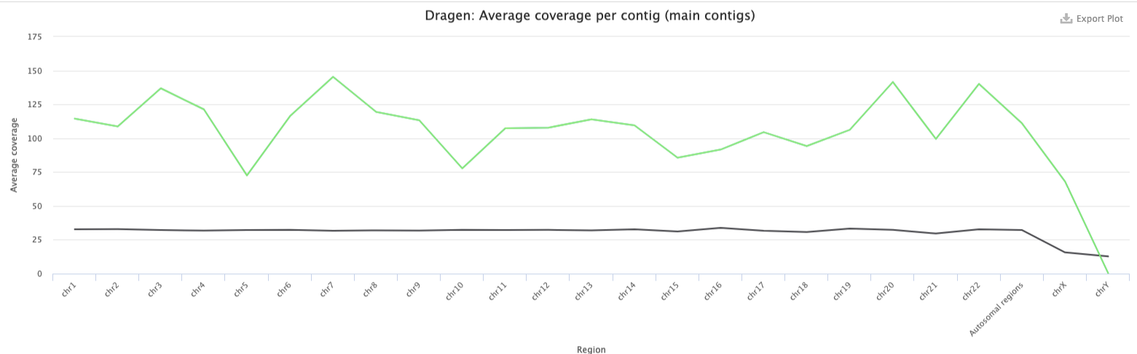
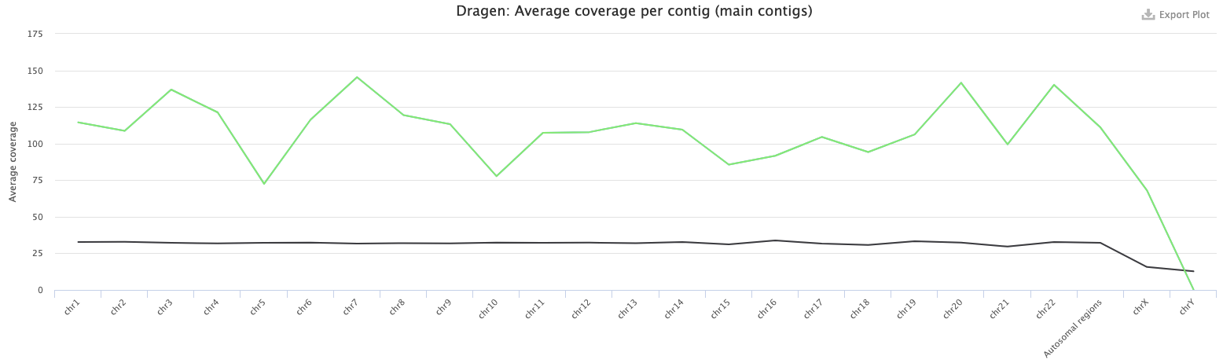
Dragen Metric: Average coverage per contig (main contigs)
DRAGEN default/UMCCR
Visual coverage difference between UMCCR and DRAGEN default references. Is this true for target genes/regions ?
HMF

Slide 14
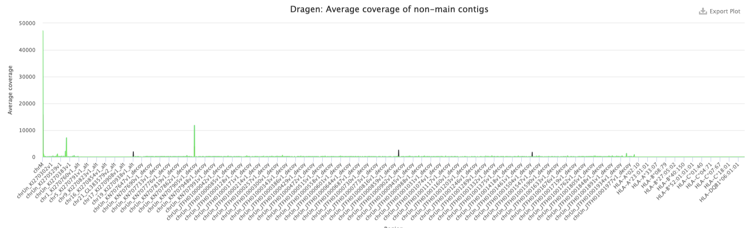
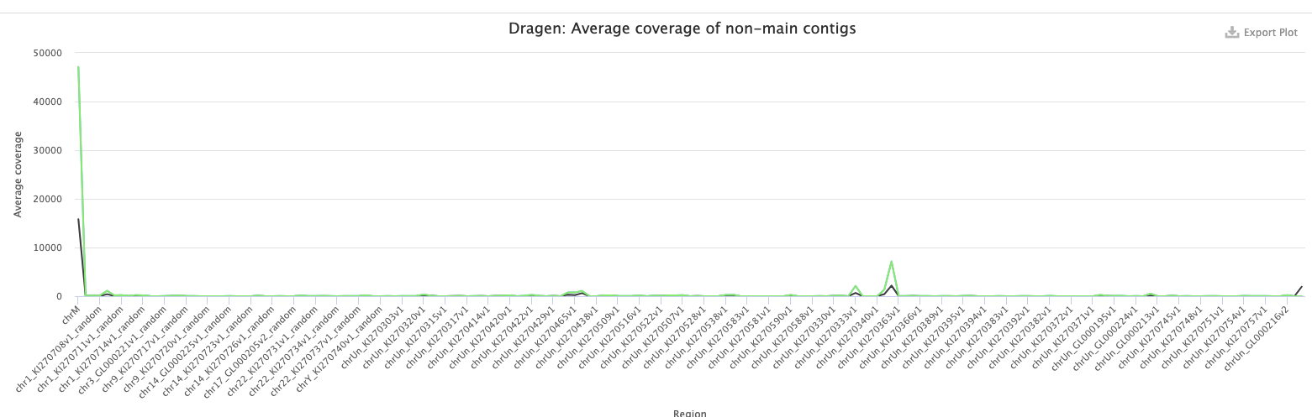
Dragen Metric: Average coverage per contig (no main contigs)
DRAGEN default/UMCCR
HMF

Slide 15
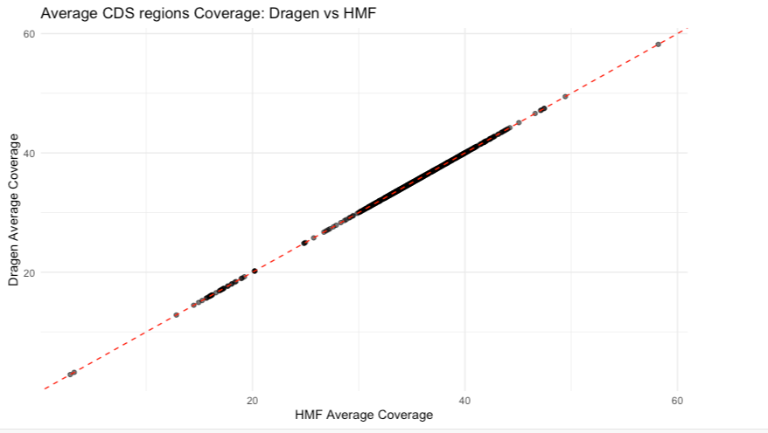
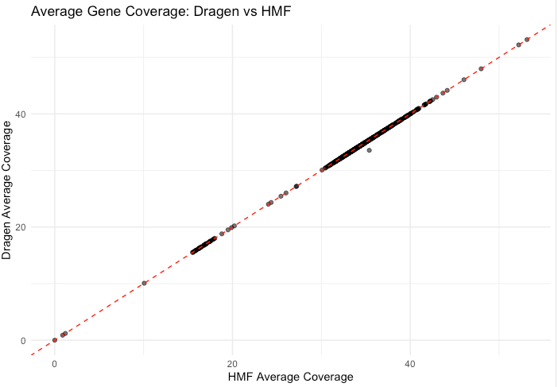
Dragen Metric: Average coverage per somatic regions of interest
T Cell Receptor Beta (TRB)
TRB have variable regions

Slide 16
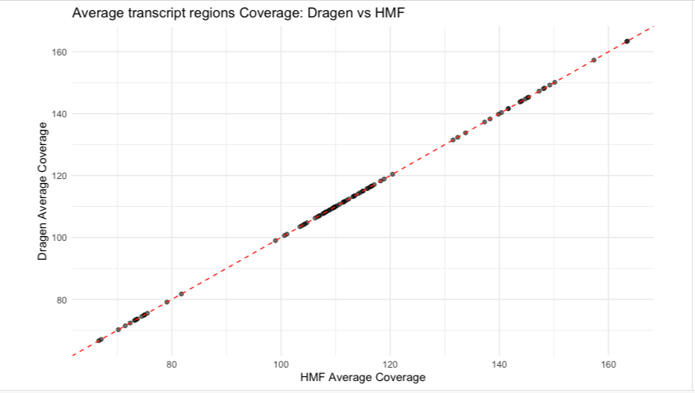
Dragen Metric: Average coverage germline per transcript regions

Slide 17
Dragen Metric: Average coverage per regions of interest
Only difference in coverage above 0,5% is for the TRB gene (5%) that have a know now variability. This may be due to HMF build, which excludes ALT contigs and decoy sequences, reads that might map ambiguously in the complex TRB region are not rescued.

Slide 18
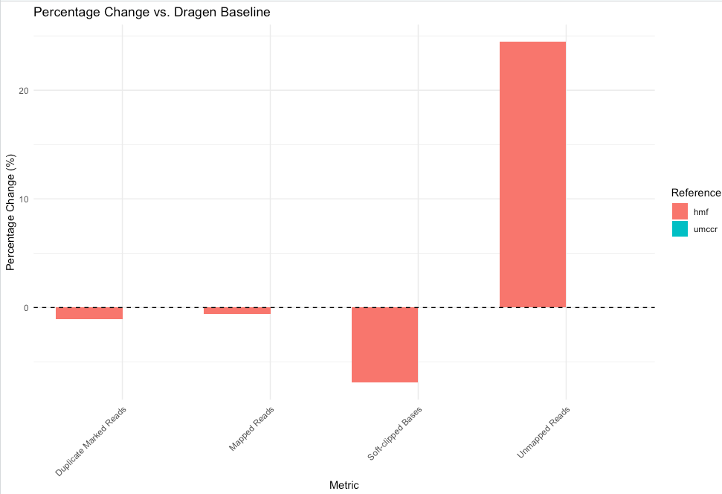
Aligment metric
Dragen Aligment
DRAGEN vs HMF reference shows:
+24% unmapped reads (-0.6% mapped reads compare on DRAGEN alignment)
-6% soft-clipped Based on DRAGEN alignment
-20% secondary alignments in Oncoanalyser

Slide 19
Aligment metric: DRAGEN vs HMF
The HMF reference lacks decoy sequences and ALT contigs.
Metrics:
+24% unmapped reads (–0.6% mapped)
–6% soft‐clipped bases
–20% secondary alignments in Oncoanalyser
In the DRAGEN/UMCCR reference, the presence even if masked of ALT sequences and decoys gives the aligner more “options” for assigning ambiguous reads. Removing these extra sequences (as in HMF) causes the aligner to reject or force a unique alignment.

Slide 20
Records Comparison

Slide 21
Record comparison summary
All discrepancies between the variant call sets were observed exclusively outside of the high-confidence regions. When using the DRAGEN reference as the truth set, the DRAGEN and Oncoanalyser variant calling achieved precision, recall, and F1 scores above 0.99 for both somatic and germline variants.
In Oncoanaliser the variants unique to each set that are high-confidence either lack any clinical significance annotation (i.e. no CLNSIG information) or are classified as benign.

Slide 22
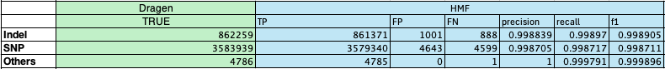
Dragen Normal hard filtred
Shared records 4,445,496
0,12%(5488) records shared by Dragen default and UMCCR reference
0,12%(5644 )records only find HMF reference

Slide 23
Dragen somatic hard filtred
Shared records 423833
0,03%(154) records shared by Dragen default and UMCCR reference
0,15%(659) records only find HMF reference

Slide 24
Oncoanalyser germline
All the records are shared between the references

Slide 25
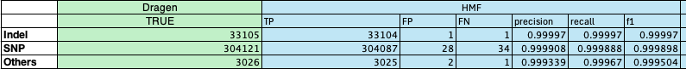
Oncoanalyser somatic
Shared records 340216
0,01%(36) records shared by Dragen default and UMCCR reference
<0,01%(31) records only find HMF reference

Slide 26
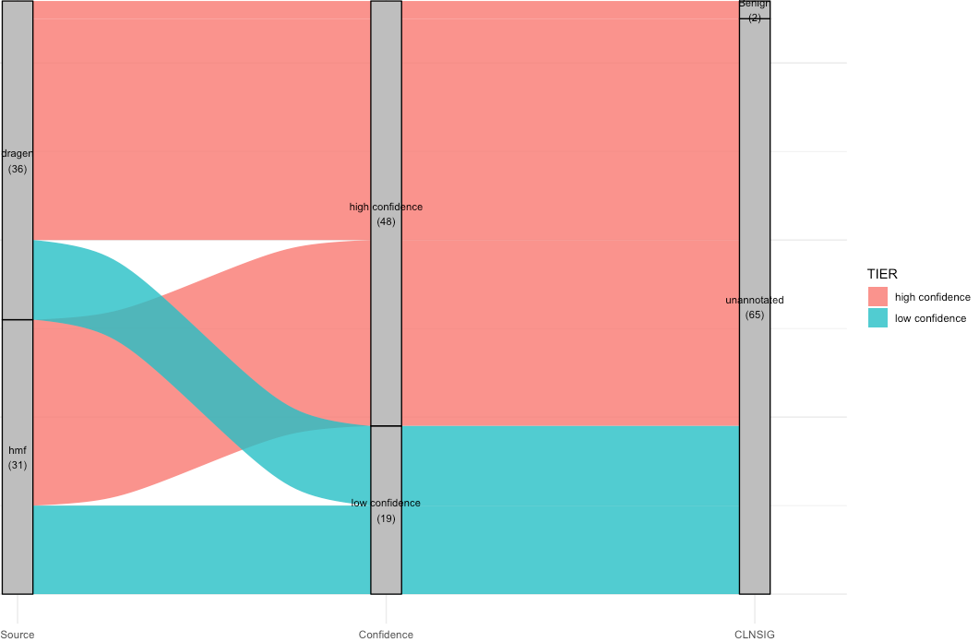
Oncoanalyser somatic
The only annotated genes with high confidence are considered benign

Slide 27
Conclusion
No major differences in alignment between DRAGEN and UMCCR references in both DRAGEN and Oncoanalyser results. Indicate no change of the masking regions for our workflow.
HMF shows slight differences, but these affect genes without clinical significance or benign that outside of high-confidence regions.

Slide 28
Next steps
DRAGEN Version Testing
Test more sample
More Metrics and Comparison

Slide 29

Thank you
Quentin Clayssen | Genomics Platform Group
Department | University of Melbourne OR Peter MacCallum Cancer Centre
quentin.clayssen@umccr.org

